Slide 1
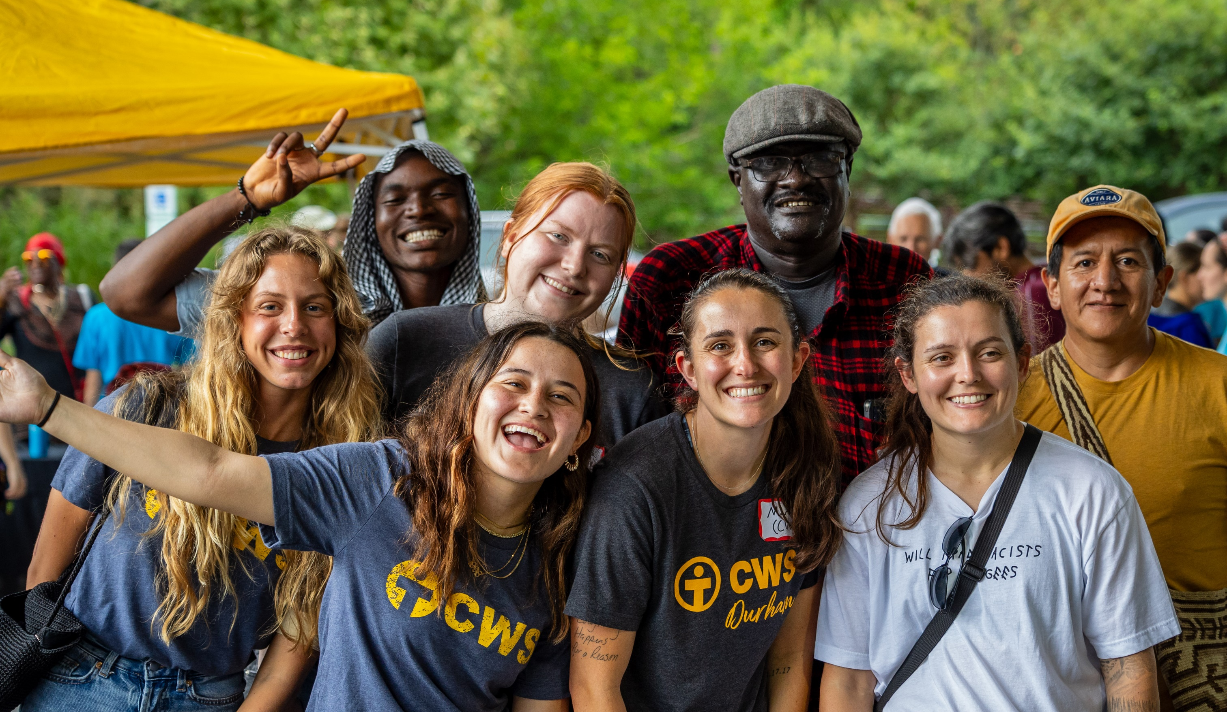

Partner with Us
FAITH, COMPASSION, AND TRANSFORMATIVE ACTION SERIES

Slide 2

Church World Service
is a faith-based organization transforming communities
around the globe through
just and sustainable
responses to hunger,
poverty, displacement
and disaster.
Notes:
Aisha and her son at CWS partner St. Andrew’s Refugee Services in Cairo, Egypt. A refugee from Sudan, Aisha is the head cook at StARS and serves lunch to hundreds of students and staff every day.

Slide 3
Cultivating Communities:
Fostering Belonging for Newcomers

Slide 4

Objectives
Understand the significance of building belonging in communities
Equip community members with tools needed to welcome newcomers to their communities
Gain insights into how Church World Service facilitates community sponsorship initiatives and how can participate

Slide 5
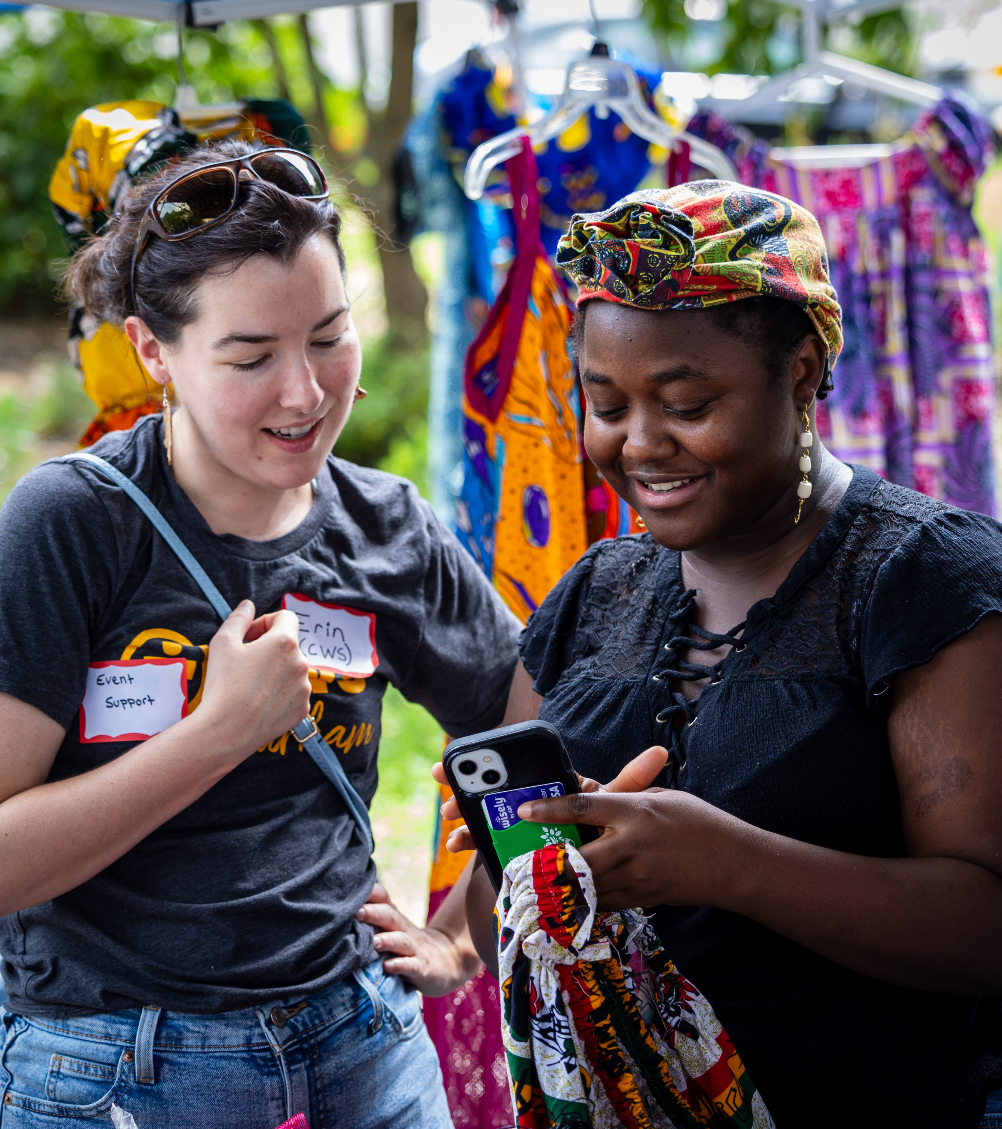
Building Belonging
Social Cohesion and Community Resilience
Cultural Enrichment and Diversity
Economic and Civic Participation
Transformed Communities

Slide 6
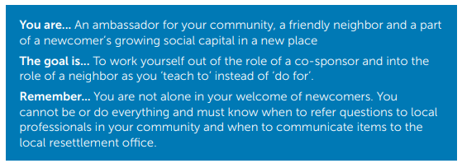
Role of Sponsors

Slide 7
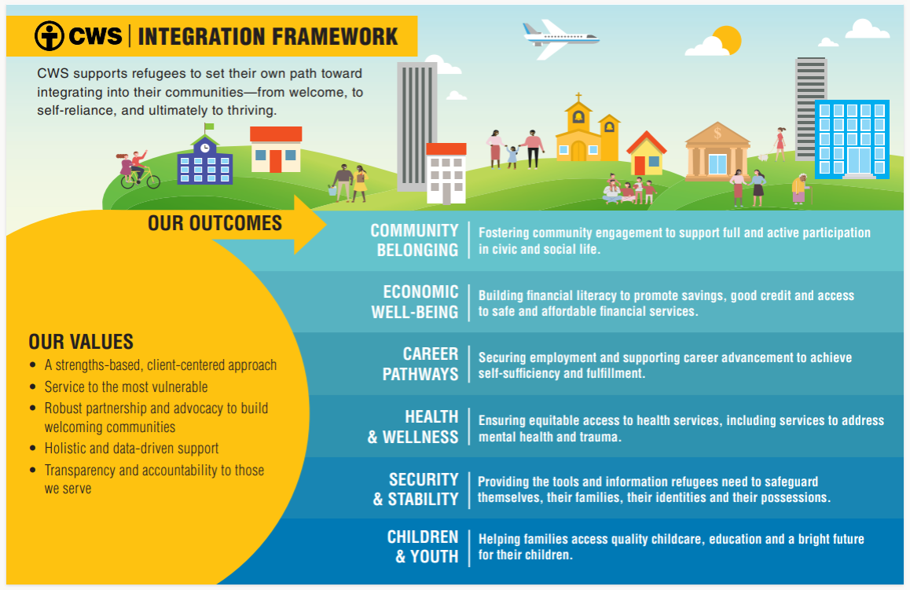

Slide 8
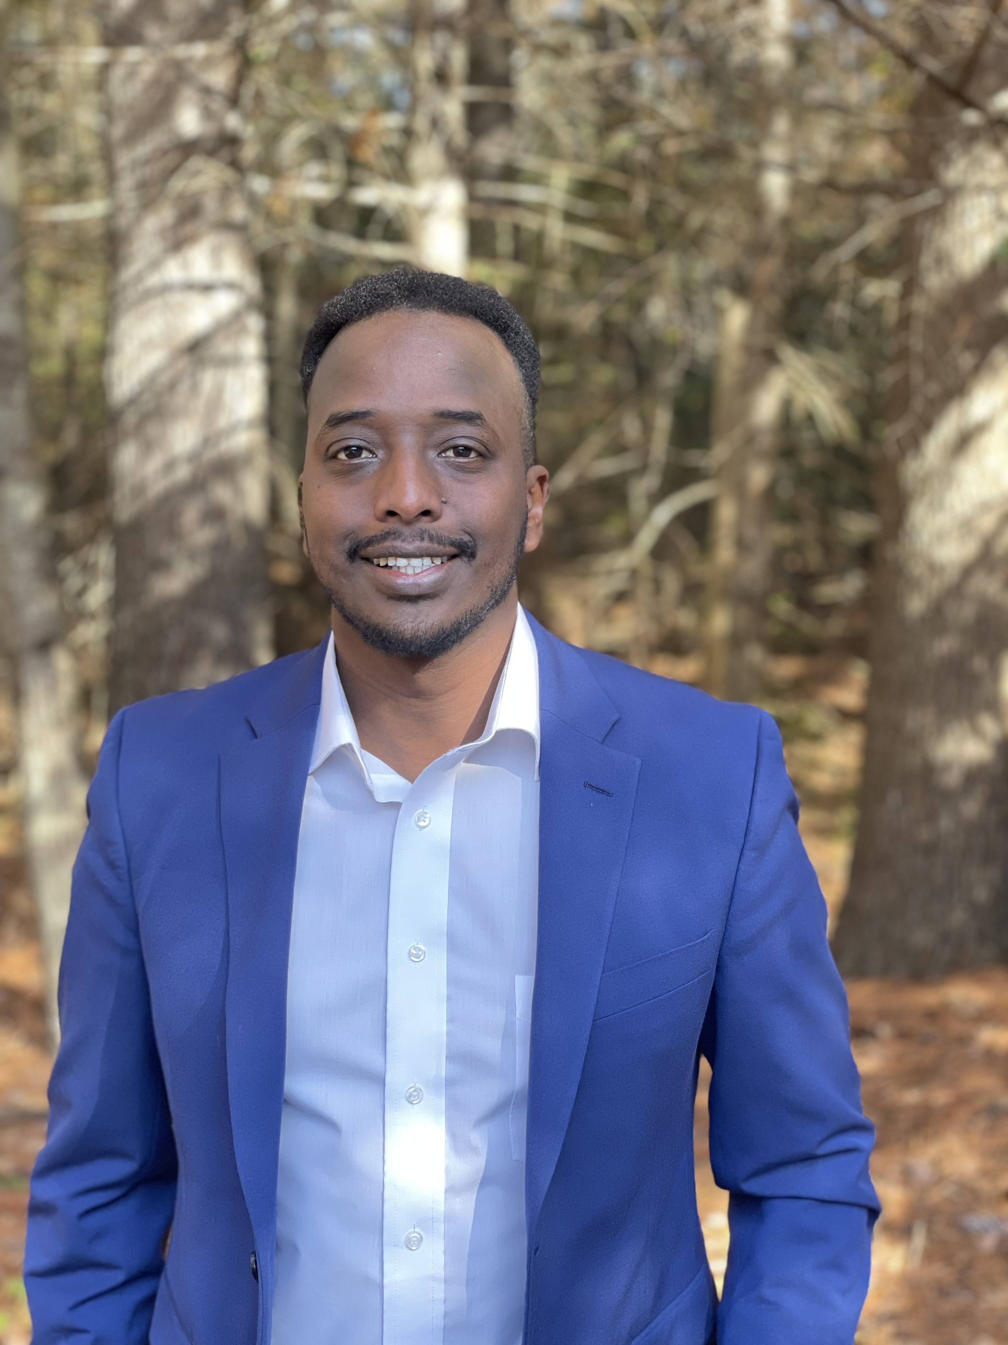
Guest Speaker
Abdi Iftin

Slide 9
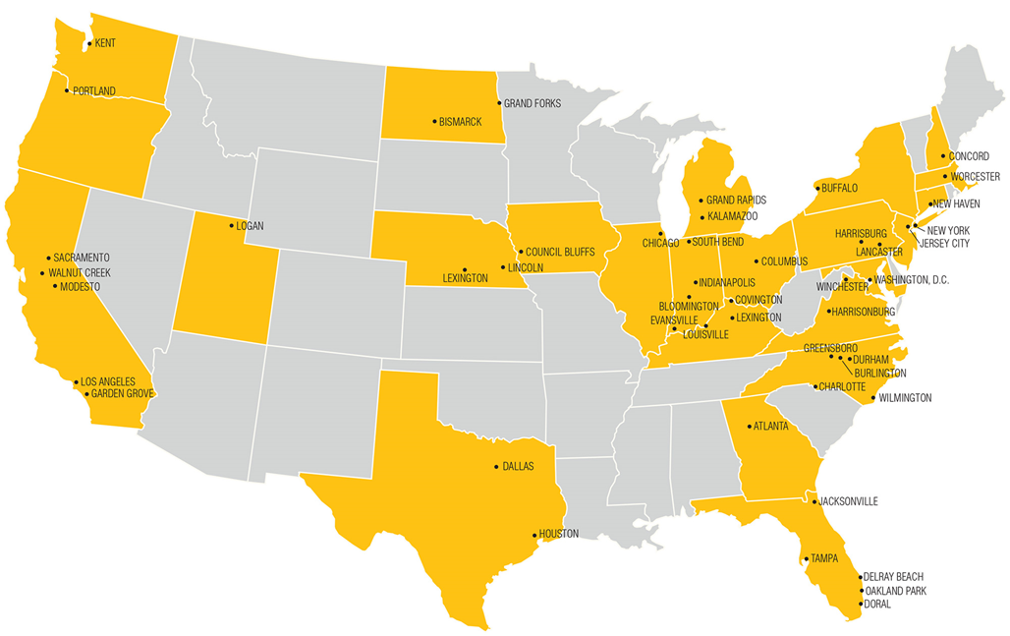
Co-sponsorship
CWS services nearly 40 offices, all have ways to be involved with new arrivals
Most offices support Co-sponsorship models: 5+ adults partnered with a new arrival for their first 90 days to complete specific services
CS groups receive support from local office
Volunteering opportunities and donation needs outside of core services

Slide 10
CWS Sponsorship Tools
Co-sponsorship Manual
Core Service Task Guides
Technical Assistance Guides
Trauma Informed Care
Co-sponsor Agreement Form
Home Set Up Guide
Post 90 Day Service and Neighbor Plan

Slide 11
Neighbor Network
Neighbor Network is an alternate pathway that provides an opportunity for everyday Americans to sponsor and welcome certain refugee populations through the Welcome Corps Program Home - Welcome Corps
CWS is a Private Sponsor Organization (PSO)
PSOs are organizations that commit to supporting Private Sponsor Groups (PSGs) through service delivery
  Oversee client safety
  Provide Technical Assistance (TA) to PSGs
PSGs are groups of 5 or more people over the age of 18
PSGs agree to:
  At least a 90-day commitment
  Provide all core services:
    Housing; benefits applications; connections to education, employment, medical care; cultural orientation; transportation
  Raise $2425 per individual
  There is no geographic restrictions on placement

Slide 12
Neighbor Network
The Neighbor Network is excited to share with you all that the eligibility criteria for naming a refugee was made public this week.
Please see links below for more information:
Sponsor a Refugee You Know - Welcome Corps
Get Ready to Apply for Somone You Know for Welcome Corps,

Slide 13
Neighbor Network Tools
Sponsorship Pathways Assessment: https://forms.office.com/r/xJmC6V4VTz
Private Sponsor Group Interest Form: https://forms.office.com/r/7yciVV3CN9

Slide 14
Join the Network of Neighbors!
Help the CWS Neighbor Network reach our goals!!!
There are 29 PSOs across 32 states of which 70 PSGs have been recruited to date
To date the CWS Neighbor Network has recruited and onboarded 4 groups with 6 more in the beginning stages of onboarding
CWS Neighbor Network needs to recruit 10 more PSGs by 12/31/2023 to meet our goal of 20 PSGs for the year
PSG goal is 30 total by April 2024
Ways to get help reach our goals
  Host a Dine for Refugees event: https://welcomecorps.org/wp-content/uploads/Dine_For_Refugees_Toolkit.pdf
  Attend an Interest Call
    Dates TBD will send out to group by end of this Month

Slide 15
Remote Placement Community Partners
CWS is seeking new partners in our Remote Placement program to resettle refugees in locations not being served by refugee resettlement agencies.
Remote Placement Community Partners might be organizations or groups who are looking to grow their welcoming programs, serve a new location, or ensure a specific refugee family is able to reunite with their loved ones close by.
Eligibility- An organization located at least 50 miles from any affiliate of a national refugee resettlement agency. If you are closer than 50 miles- we still want to talk to you! We might be able to work with your organization even if you are closer to a local resettlement agency if there is a need in your community to provide welcome to refugees.

Slide 16

Remote Placement Community Partner Tools
We are currently searching for a connection with a new partner in Opelika, Alabama to help welcome three families!
Do you know of an group or organization who have helped to welcome Afghan or Ukranian refugees and is eager to partner with a national team for increased support? Refer them to the CWS Remote Placement Community Partner team!

Slide 17

Remote Placement Community Partner Tools
Remote Placement Information Guide

Slide 18
Refugee Welcome Collective

Slide 19

WHO WE ARE
The Refugee Welcome Collective (RWC) is a Community Sponsorship (CS) Technical Assistance (TA) provider.
We aim to improve outcomes for refugees resettled through the U.S. Refugee Admissions Program by building capacity and expanding community sponsorship.

Slide 20

WHAT WE DO
In-depth Training Programs​
Technical Assistance ​
Tools and Resources ​
Knowledge Sharing for sponsors, community sponsorship staff, refugees, volunteers, community, and institutional partners across nine national resettlement agencies and their affiliated organizations.

Slide 21
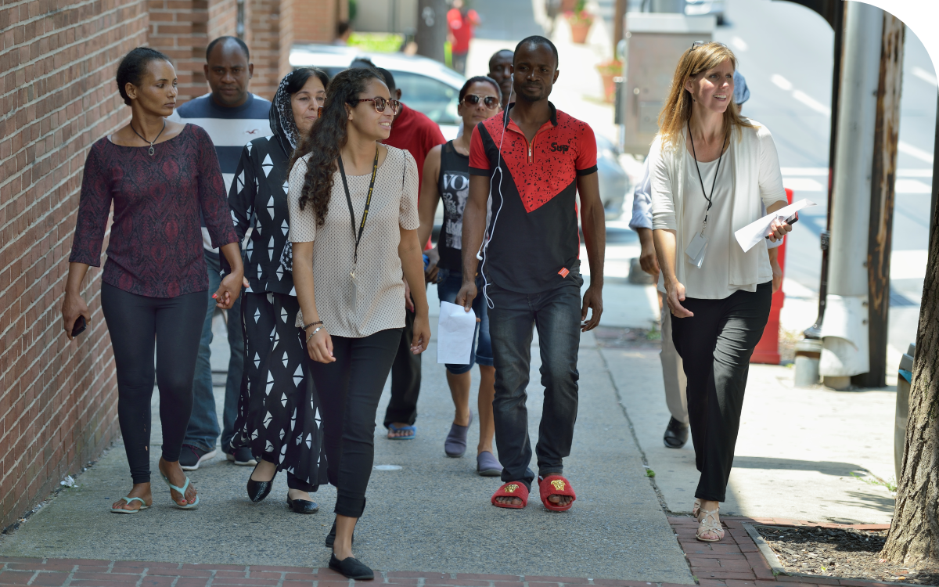
HOW WE DO IT
We work closely with national and local resettlement agencies, sponsors, volunteers, and refugees paired with sponsors through our Collective to identify needs, develop tools, resources, and set priority areas.

Slide 22


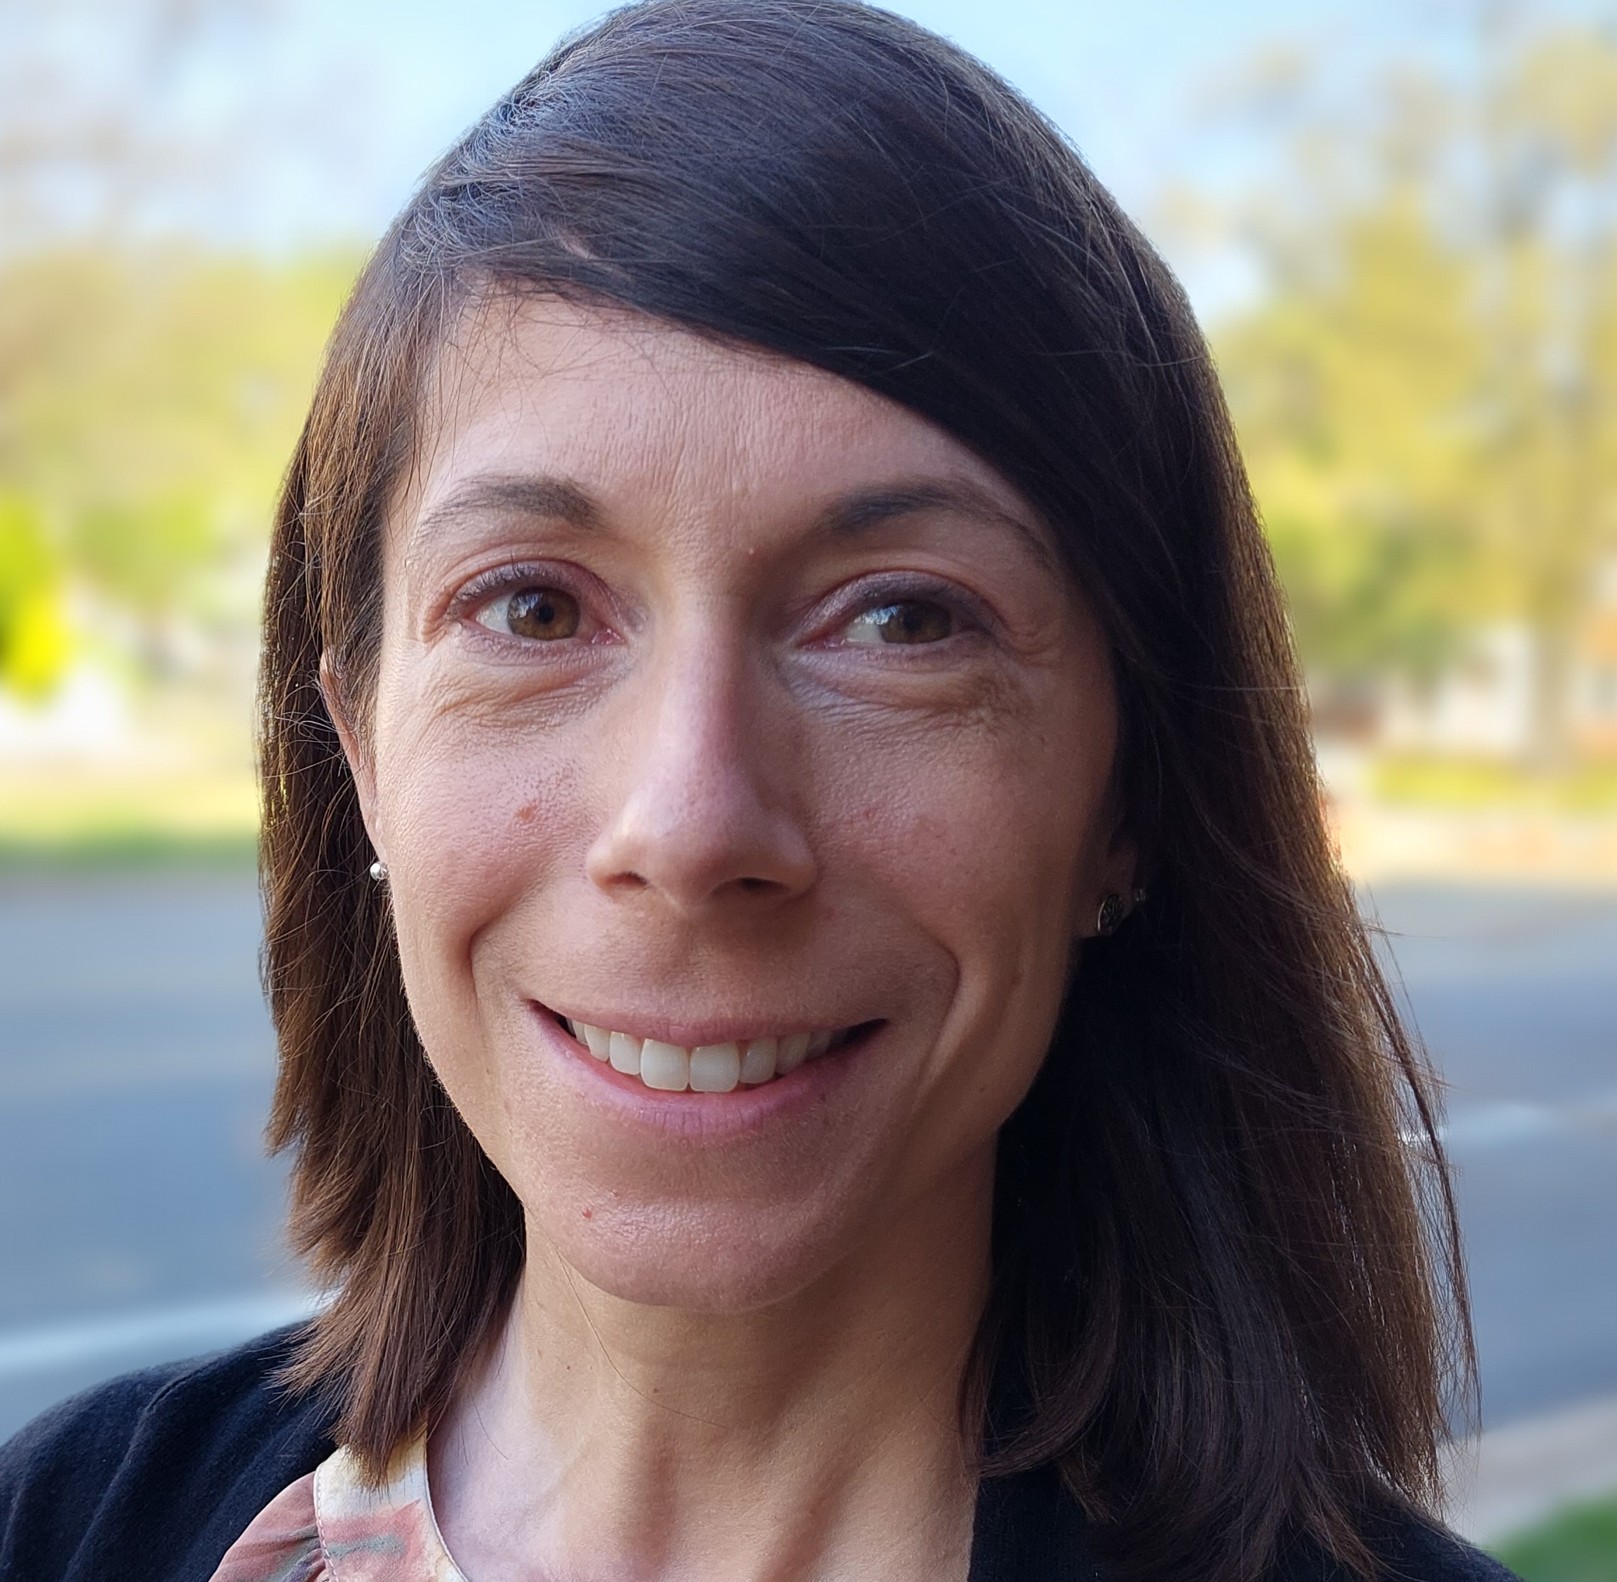

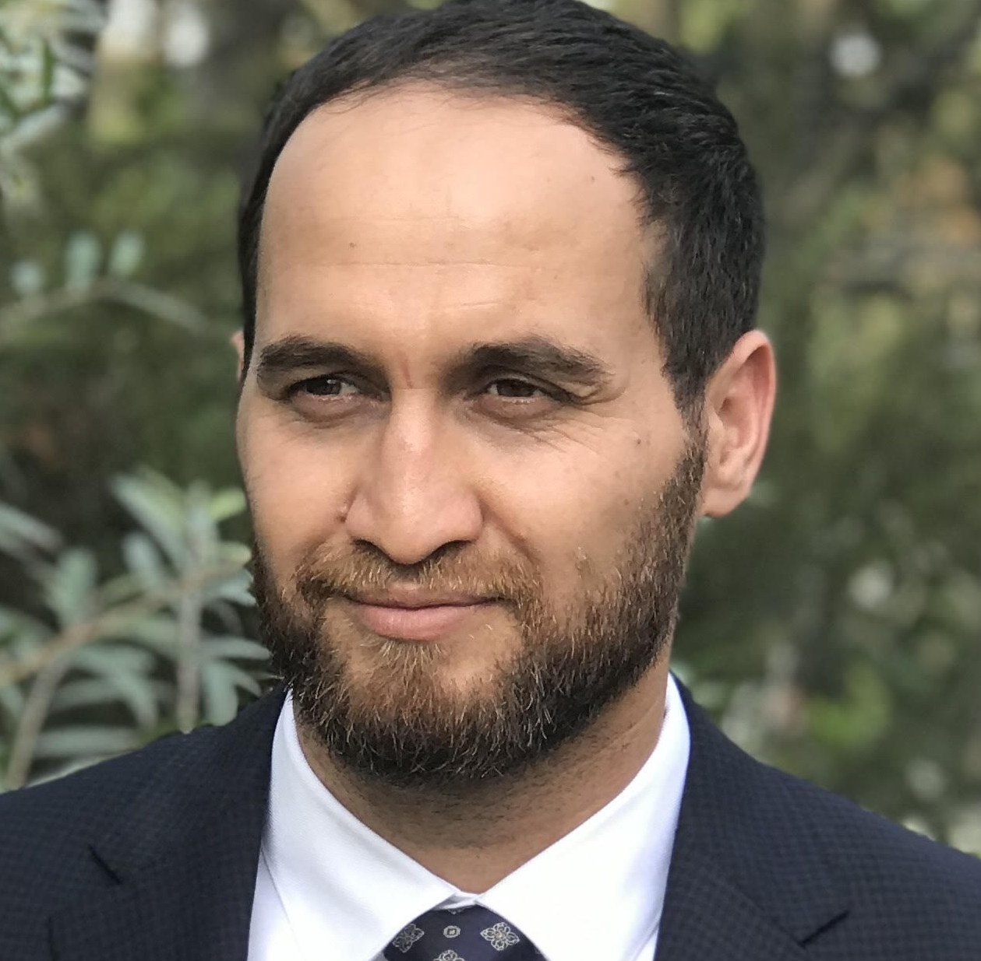





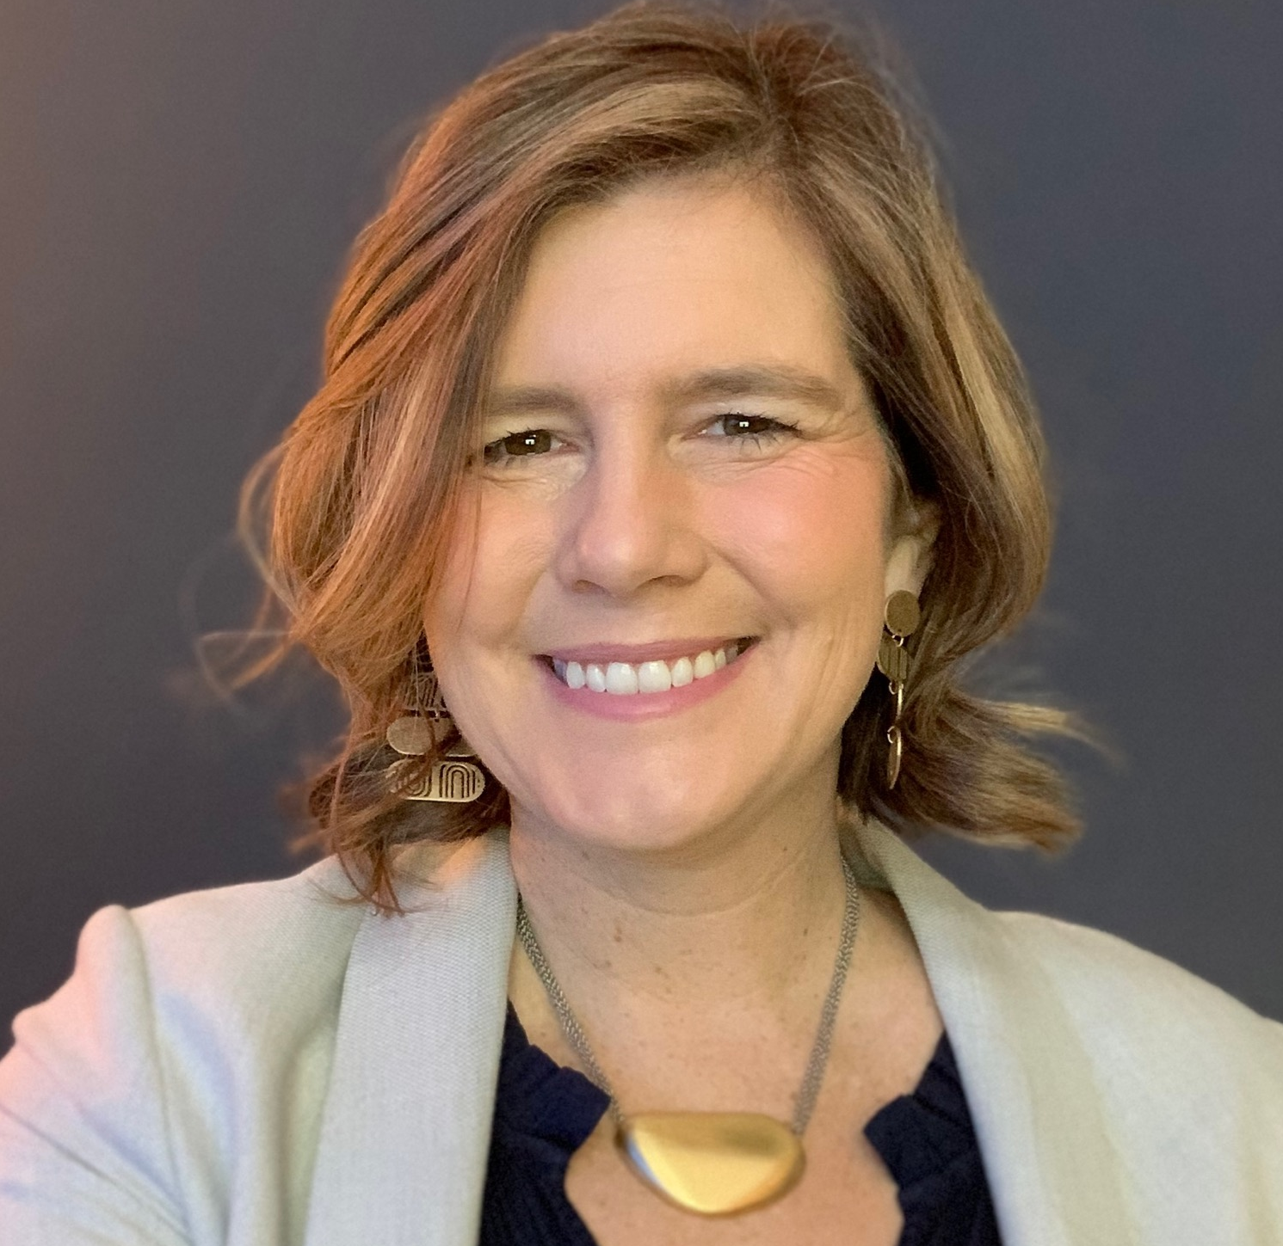
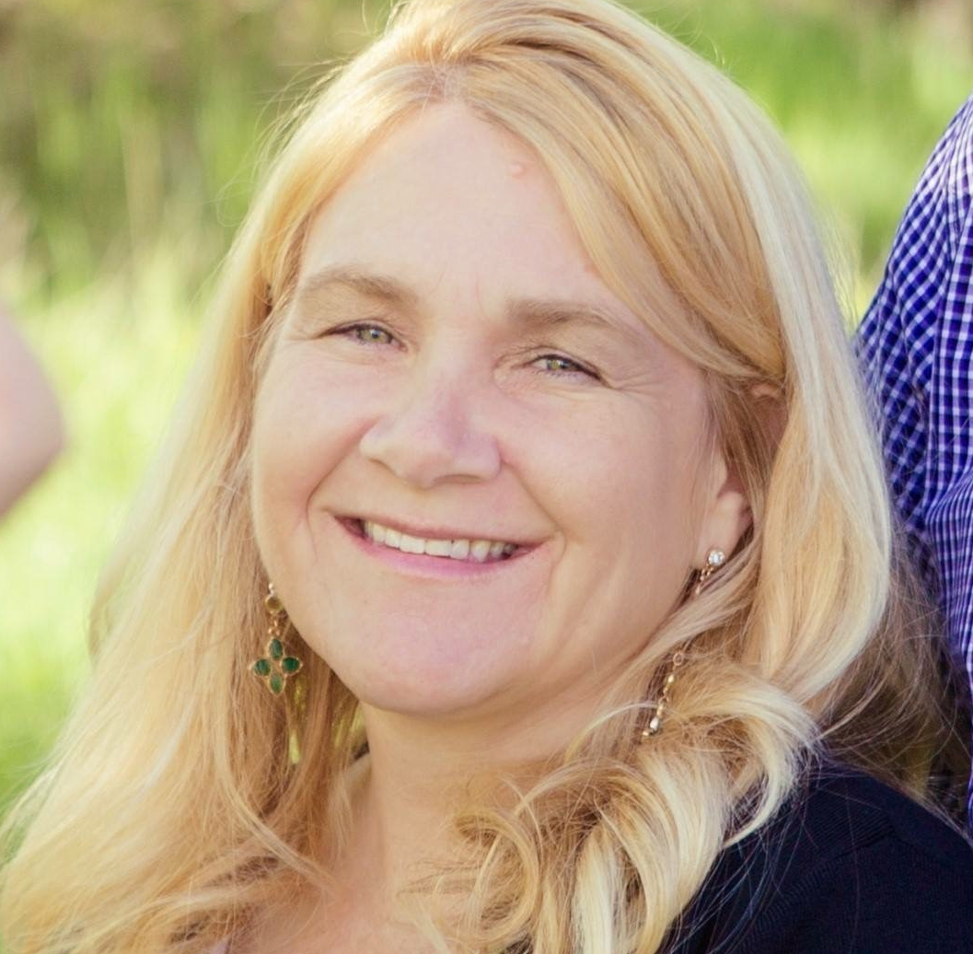

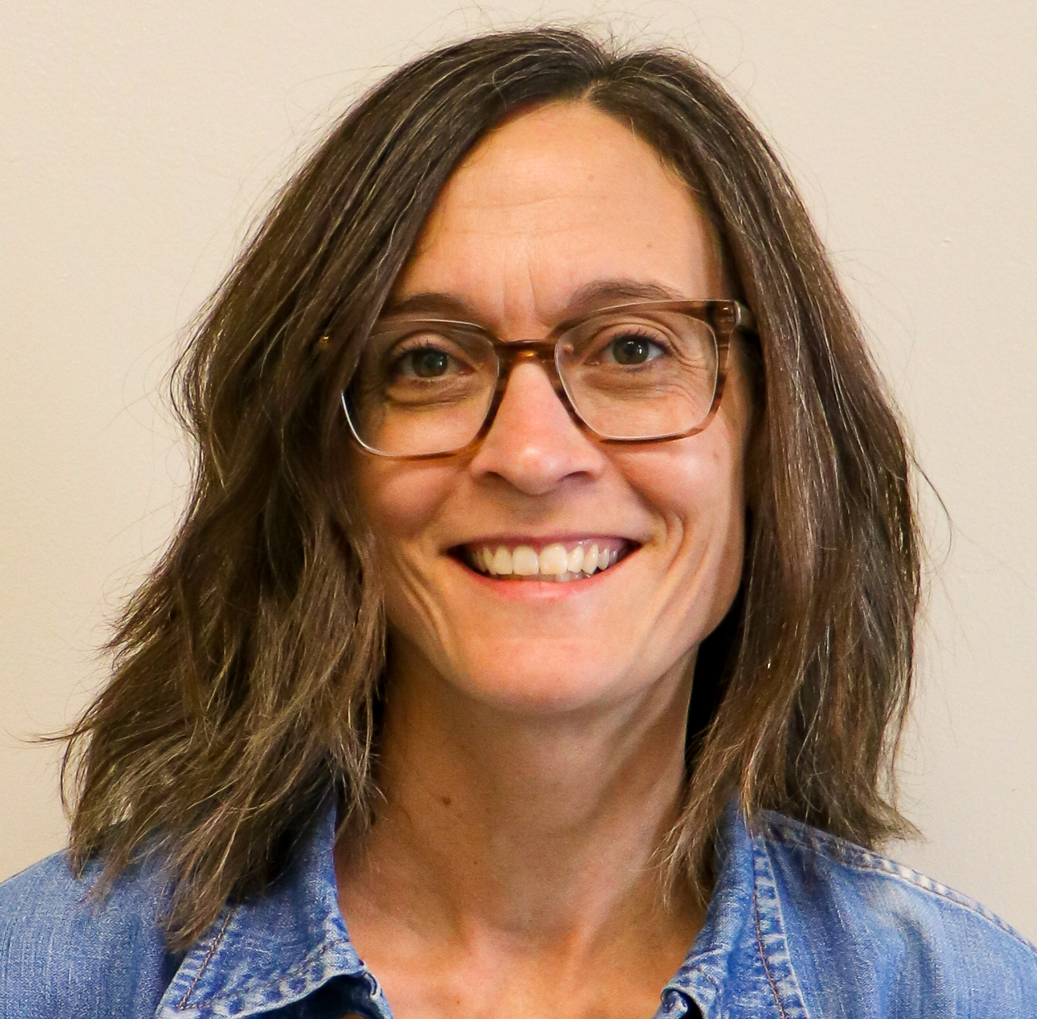
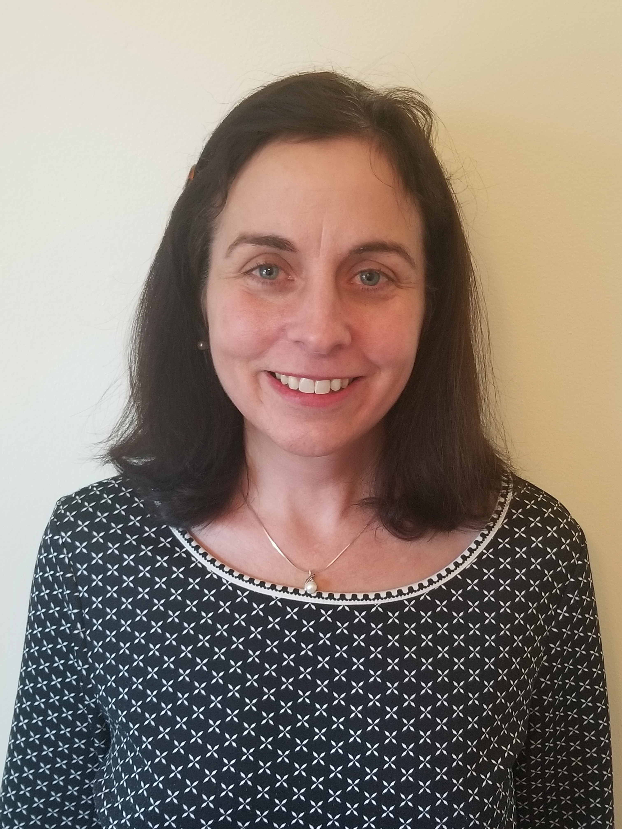

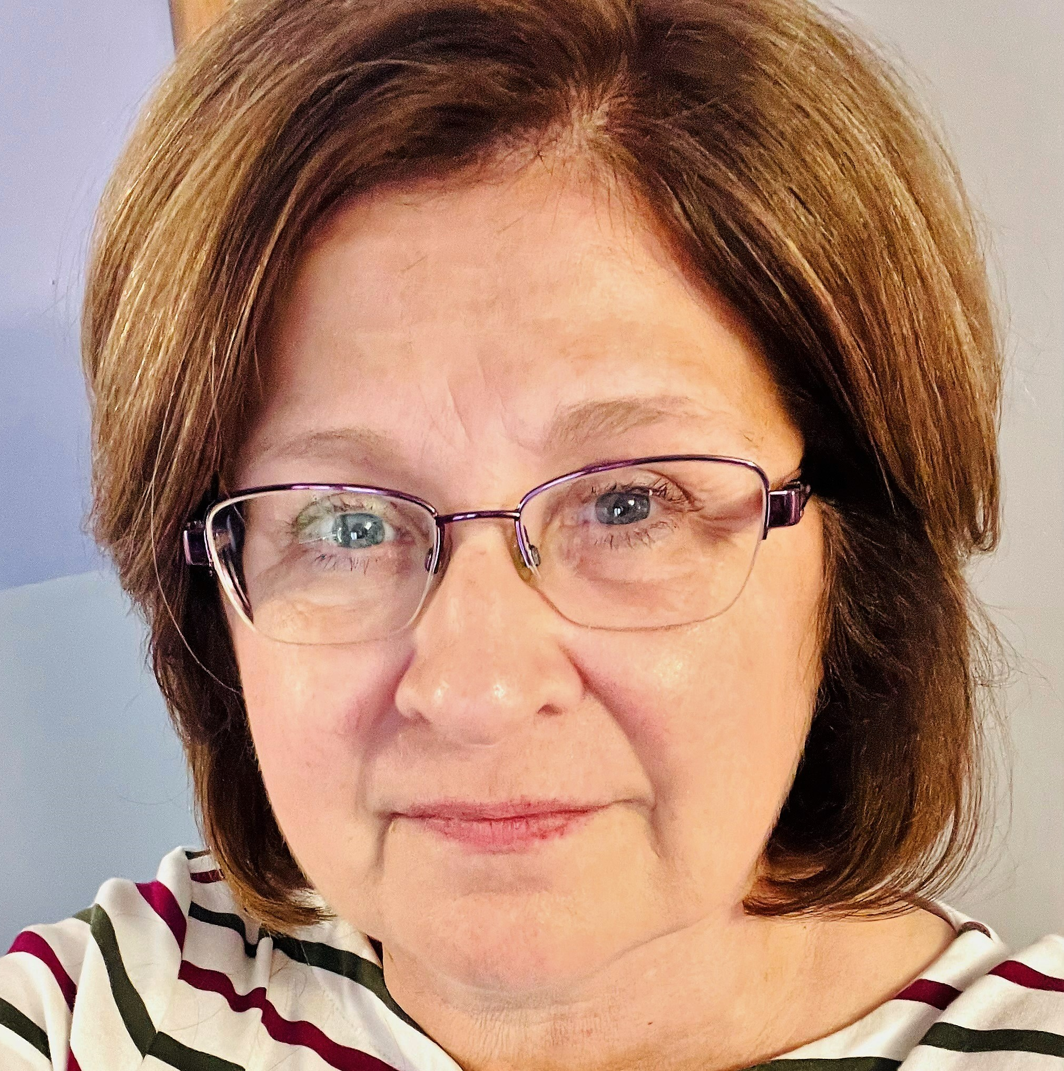
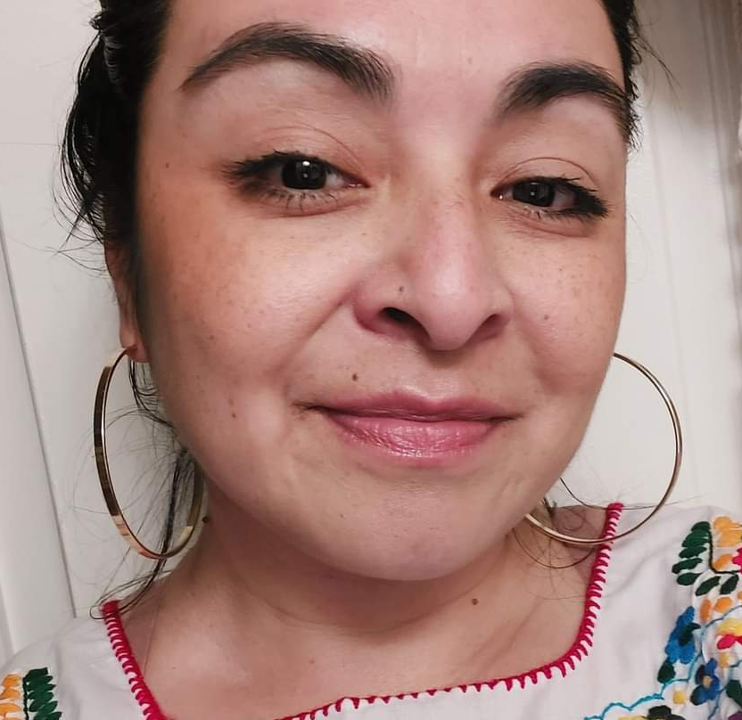
OUR COLLECTIVE MEMBERS
Collective members are community sponsorship experts from national and local resettlement agencies located across the United States.
We have 19 members and are growing. Local members are from Ann Arbor, MI; Denver, CO; Kansas City, MO; Knoxville, TN; New Bern, NC; Northeast Kansas; Oakland, CA; Pittsburgh, PA; Raleigh, NC; and San Jose, CA.

Slide 23

WHY WE DO IT
Because refugee and community sponsor partnerships make strong and vibrant communities that benefit us all. Our Collective connects a nation of dedicated sponsors, capable newcomers, and knowledgeable resettlement staff facilitating an effective structure through which communities thrive.

Slide 24
Community Sponsorship Essentials

Slide 25


Slide 26
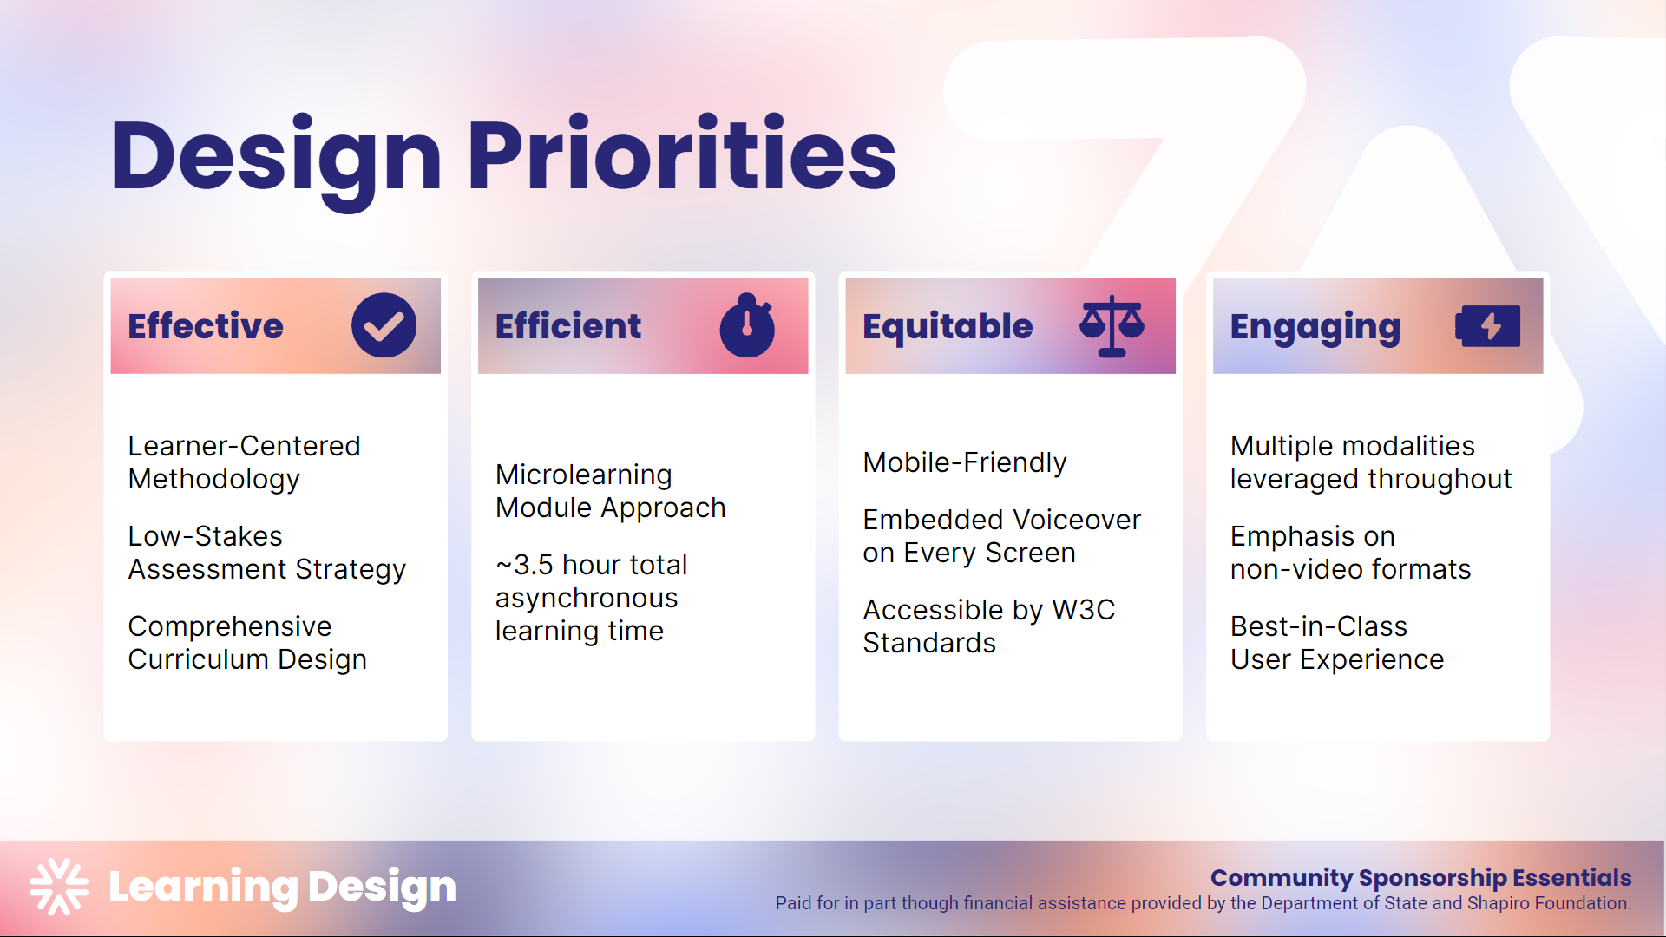

Slide 27


Slide 28
Knowledge Sharing

Slide 29

Lunch and Learns
LUNCH AND LEARNS Live public sessions for volunteers, community sponsors, resettlement agency staff, local advocates, and anyone who is interested in learning more. Featuring guest speakers and covering critical topics for supporting refugee families in the communities.
Platform: Zoom Webinar
Frequency: Twice a month
Scheduling: Mondays, 12 PM EST
Duration: 1 hour
For links to recordings and to register for upcoming sessions, visit: Engage - Refugee Welcome Collective

Slide 30
Technical Assistance

Slide 31

Technical Assistance (TA)
Tailored one-on-one or group sessions with experienced associates that can include education, troubleshooting, planning, brainstorming, and general discussion around topics relevant to community sponsorship.
To book a TA session, visit: Technical Assistance - Refugee Welcome Collective

Slide 32
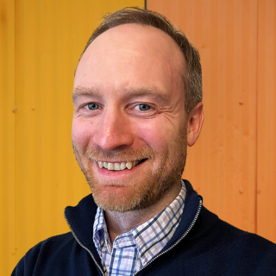
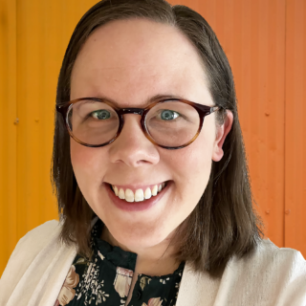



TA Providers
David Sulewski
Associate Director
Training and Technical Assistance
Jessica Ashcraft
Senior Program Officer
Community sponsorship
Joy Mikhail
Senior Program Officer
Sponsorship
Derek Feldman
Program Officer
Private sponsorship
Leya Neema
SPO
Welcome Corps

Slide 33
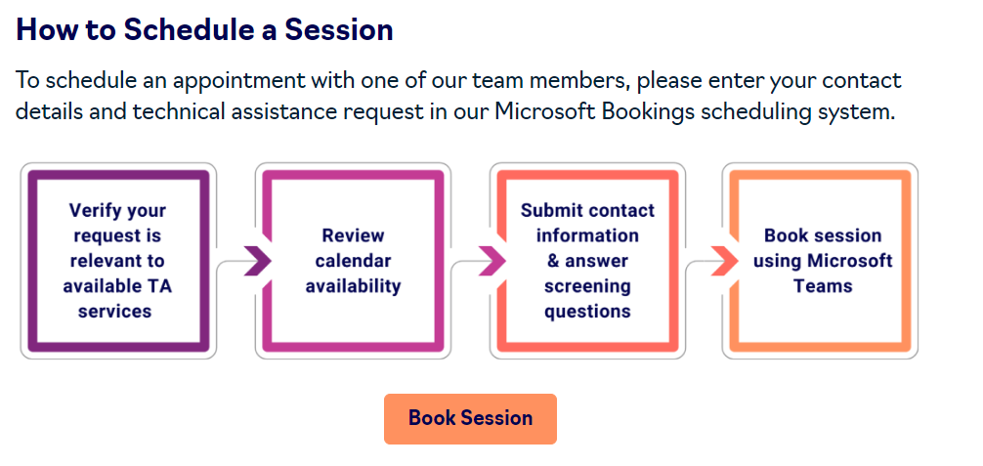
TA Eligibility
Community sponsorship agency staff
Community sponsorship groups
Refugees paired with sponsors
RWC App users
Other ORR-eligible populations (Afghan, Cuban, & Haitian humanitarian parolees, Cuban & Haitian entrants, asylees, and SIVs)
Financial supports & volunteers working with ORR populations
Agency staff working with ORR populations and UHPs

Slide 34
Example TA topics
Support using any RWC resource, integrating any learnings from RWC trainings, and follow-up from any RWC knowledge sharing opportunity.
Designing a community sponsorship program.
Understanding core services and empowering sponsors to deliver core services.
Building understanding between case managers and supporters/sponsors or refugees.
Understanding best practices related to confidentiality, boundaries, or power dynamics.
Guidance for case managers on how to work with financial supporters.
Cultural considerations and norms working with supporters/sponsors or refugees.

Slide 35

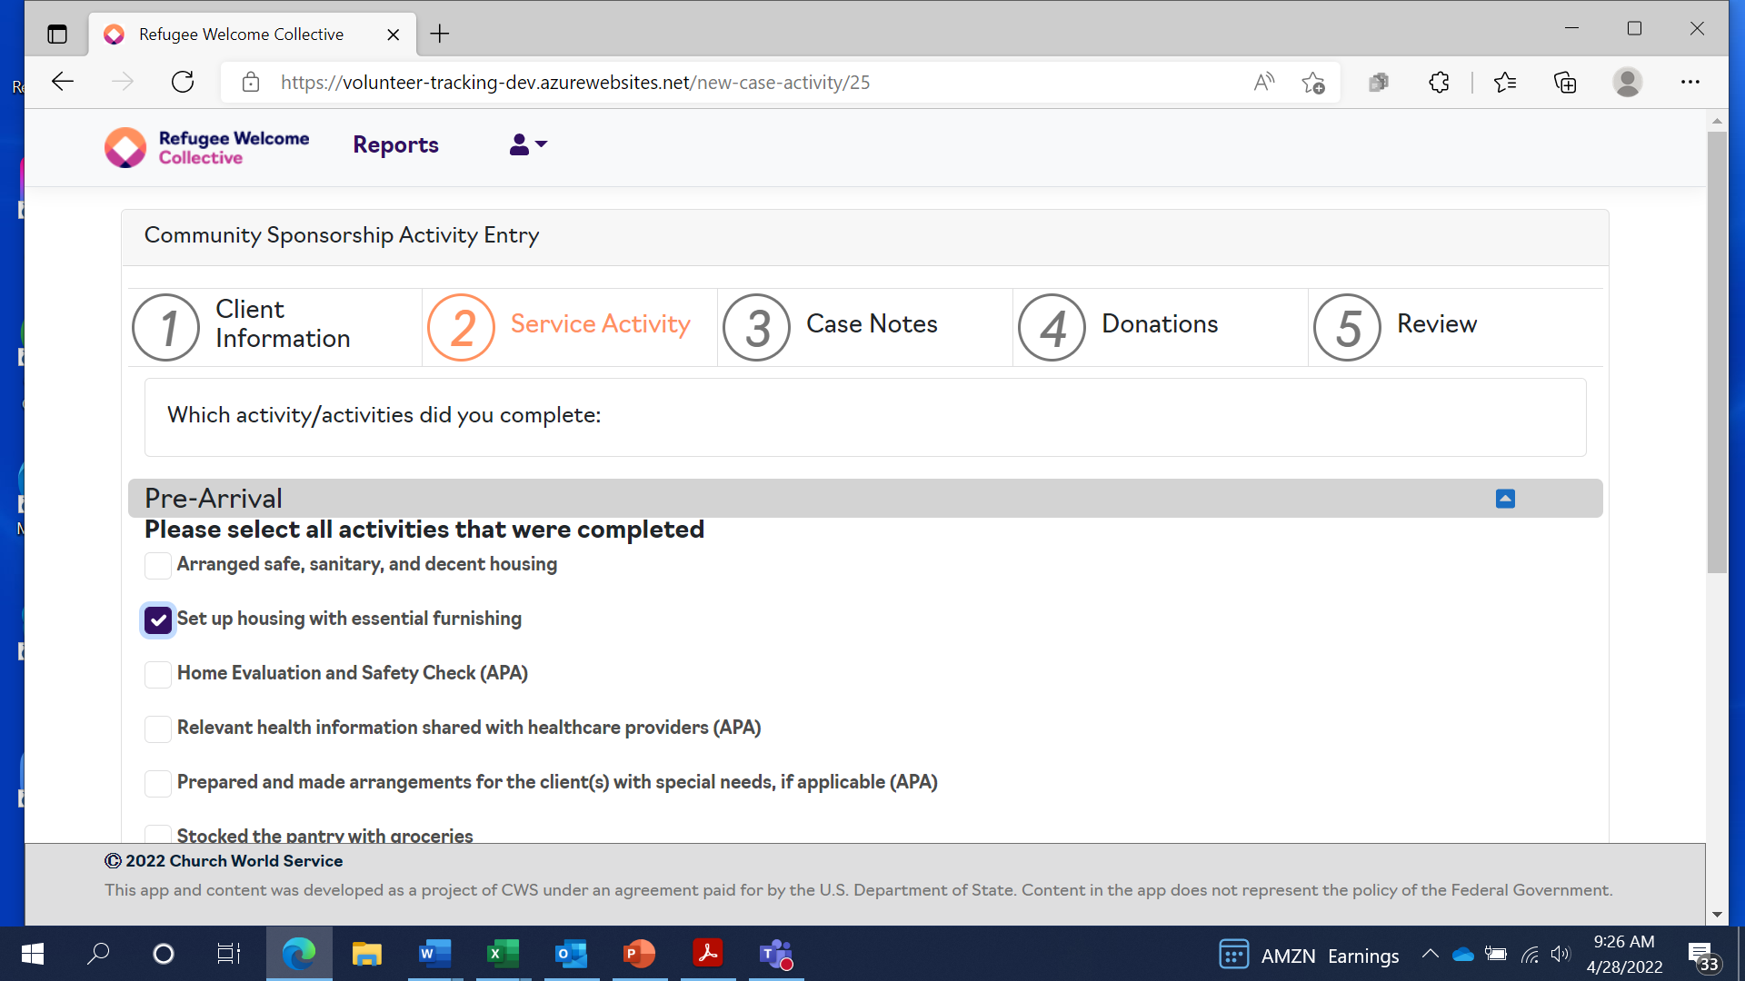

WelcomeWorks Features
Stay on Track: Access checklist of core services.
Never Miss a Deadline: Real-time deadlines ensure timely completion of tasks.
Take Notes and Track Mileage: Easily jot down notes on completed activities, track mileage, and translation services.
Log In-Kind Donations: Keep a record of in-kind donations and effortlessly monitor your contributions.
Collaborate with Ease: Sponsors stay connected by viewing and tracking activities completed by fellow members.
Notes:
Photo 154690137 © Prostockstudio | Dreamstime.com
Photo 245844355 © Jantakon Kokthong | Dreamstime.com

Slide 36
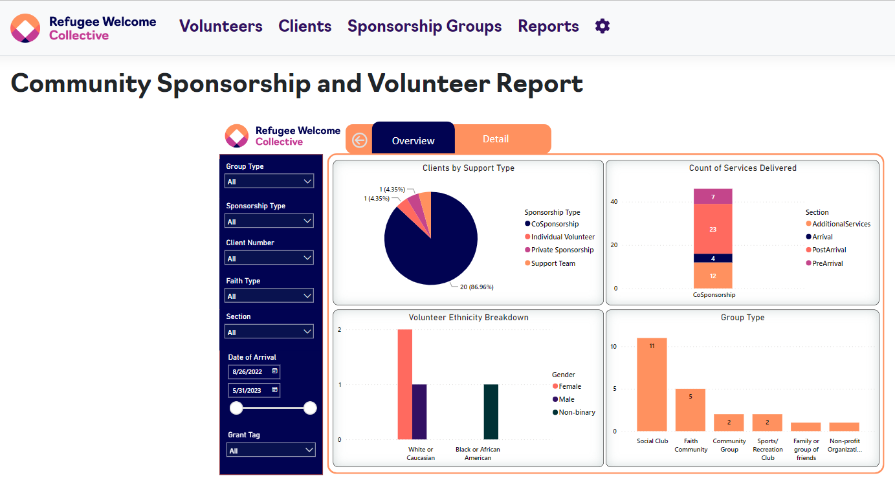
WelcomeWorks Features Cont.
Progress at a Glance: real-time information on the progress of sponsor groups.
Simplify Reporting: Access notes from sponsors on completed activities, streamlining reporting.
In-Depth Analytics: Dive into valuable data on sponsor hours, donated mileage, translation, and both in-kind and financial donations made.
Generate Insightful Reports: Generate reports for reporting and learning purposes, fostering continuous improvement.
Notes:
Photo 154690137 © Prostockstudio | Dreamstime.com
Photo 245844355 © Jantakon Kokthong | Dreamstime.com

Slide 37
Visit refugeewelcome.org for community sponsorship resources
and to stay engaged.

Slide 38

Action Steps
Donate to Emergency Needs
of the Newcomers We Serve
1
Take the Assessment:
Explore the Type of Sponsorship Best for You
2
Sponsor through the Neighbor Network
3

Slide 39
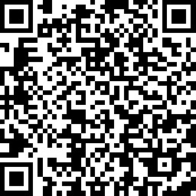
Please provide feedback!
Scan the QR code with your phone's camera to complete a brief survey or visit:
https://www.surveymonkey.com/r/CM68LVT
cwsglobal.org | refugeehousing.org
Refugee Housing Solutions is a project of CWS under an agreement paid for by the U.S. Department of State.

Slide 40

Thank you!
https://cwsglobal.org/partnerwithCWS

